Slide 1
Data Distillery
Group 12

Slide 2

Introduction:
Following the governments instructions: we have developed a wine website to give a tourist easy access to not just the splendour of South African wines but the wines of the world. The dissection of our methods will now be covered.

Slide 3
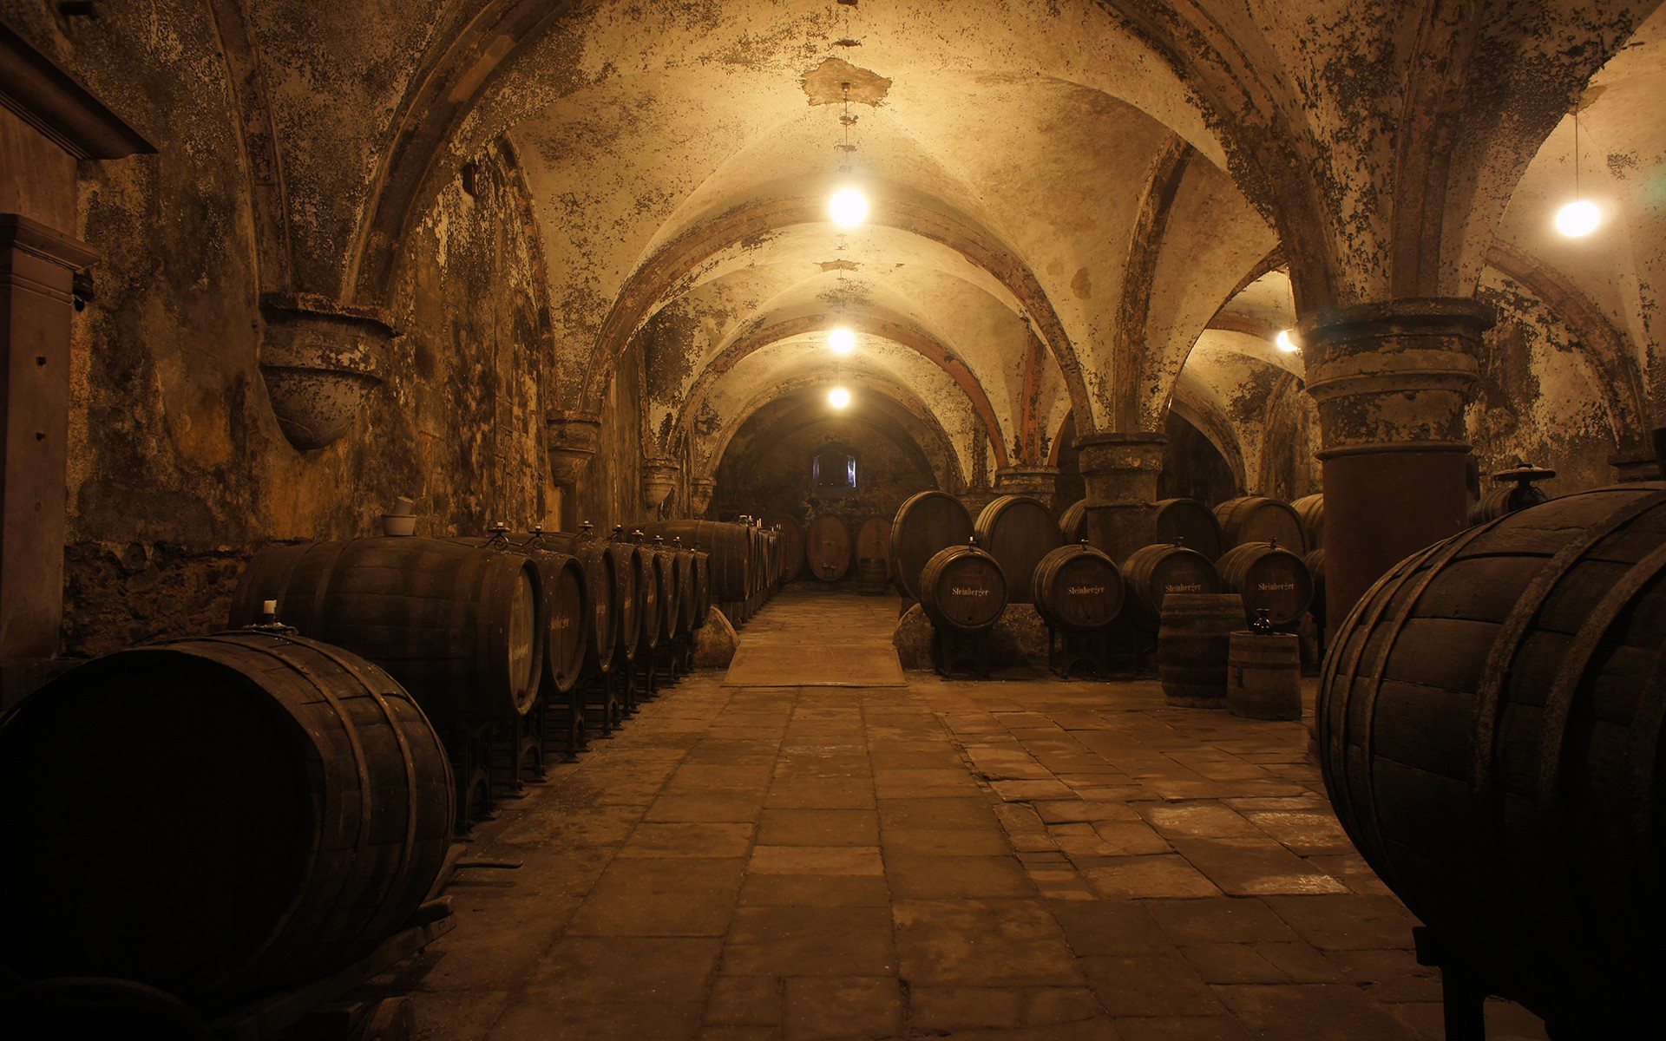
Research
PRESENTED BY JANICKE : STN
The wine industry massively contributes to South African tourism thus a centralised website for easy access to information about wines helps to give our tourists a more enjoyable experience without the hassle of having to do their own research about wineries and wines. A detailed overview of our research can be found in the research doc.
Research Document
3

Slide 4

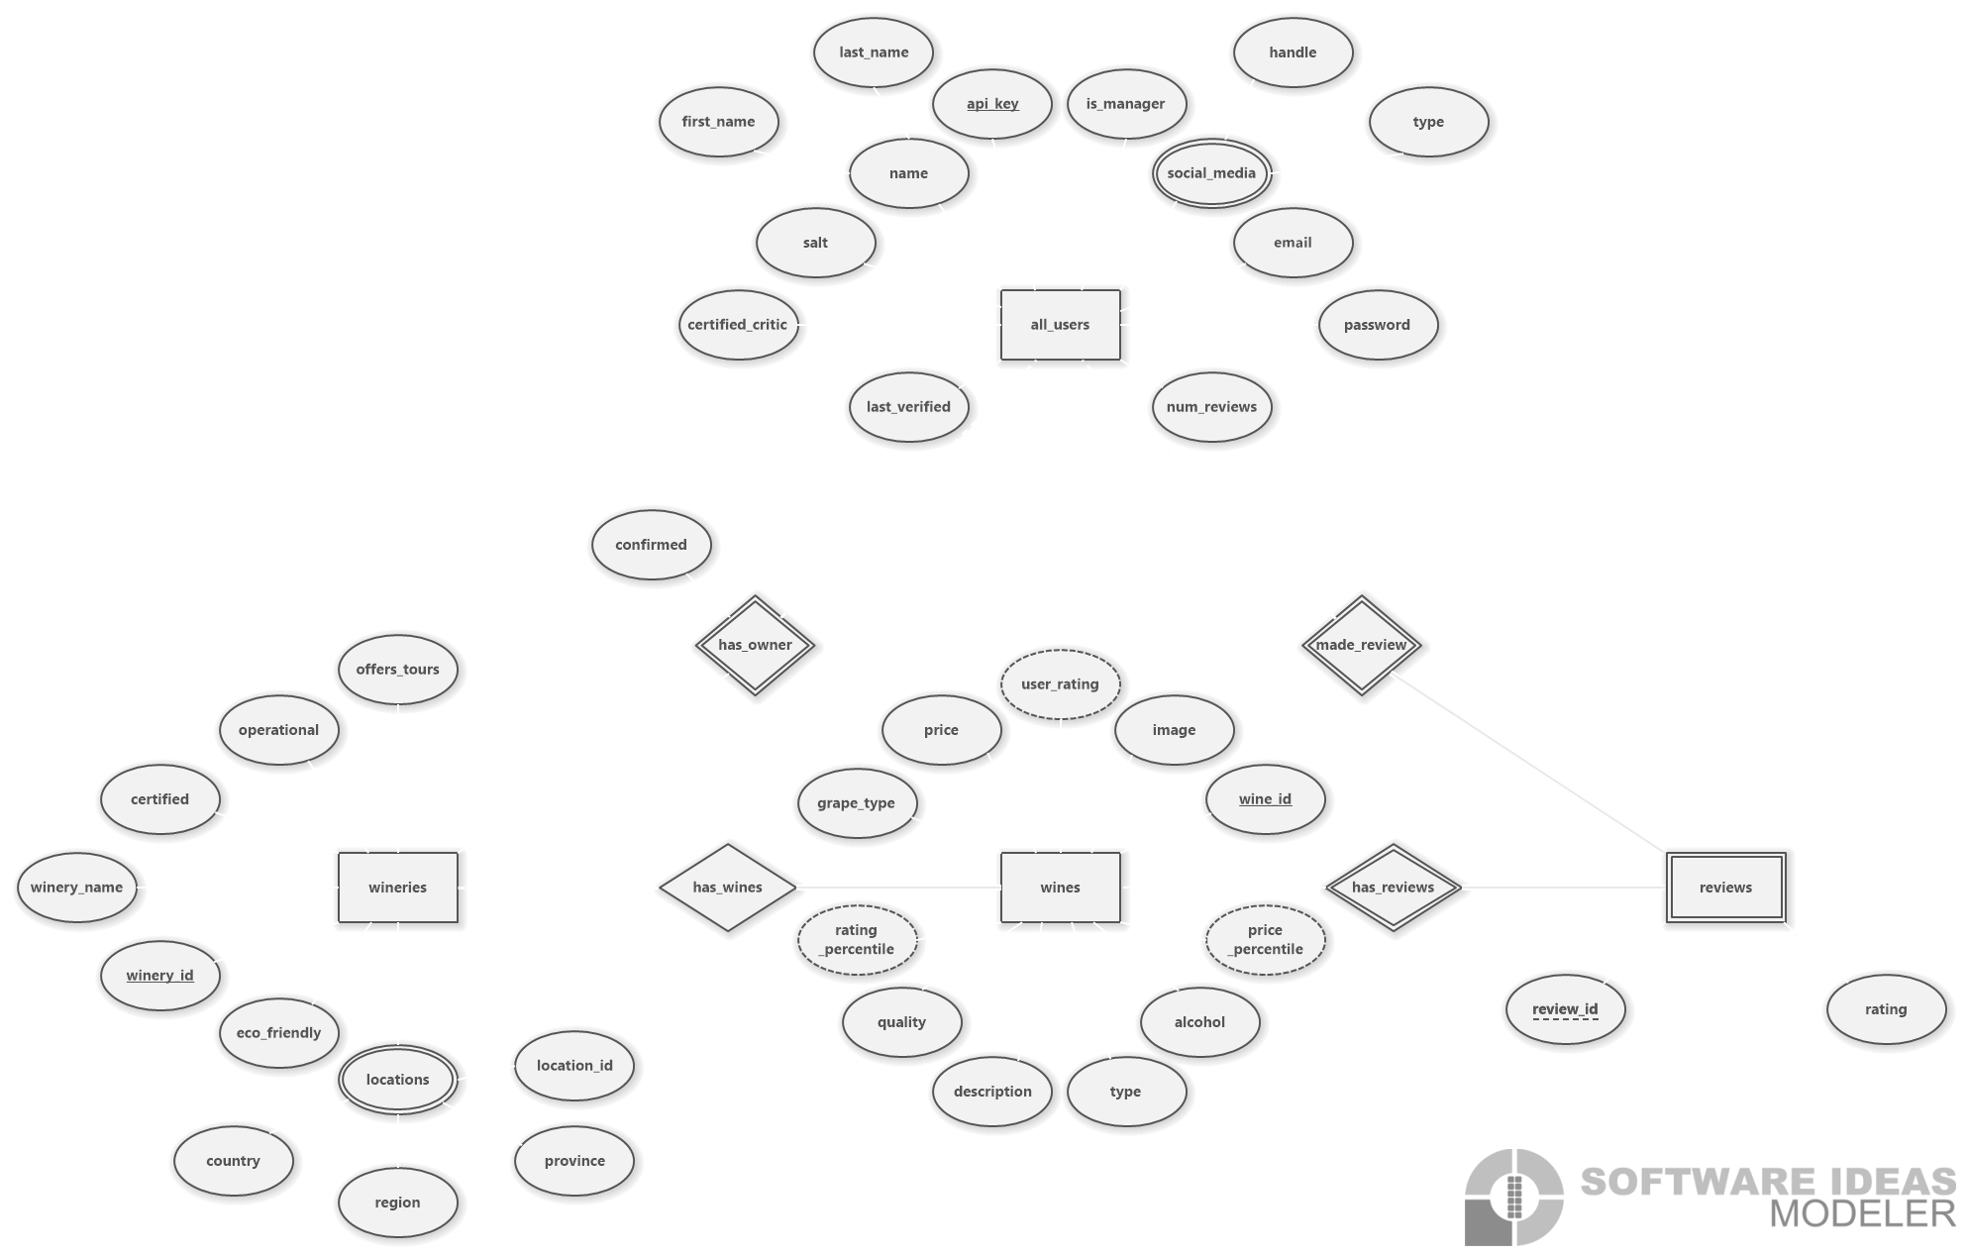
(E)ER-Diagram

Slide 5
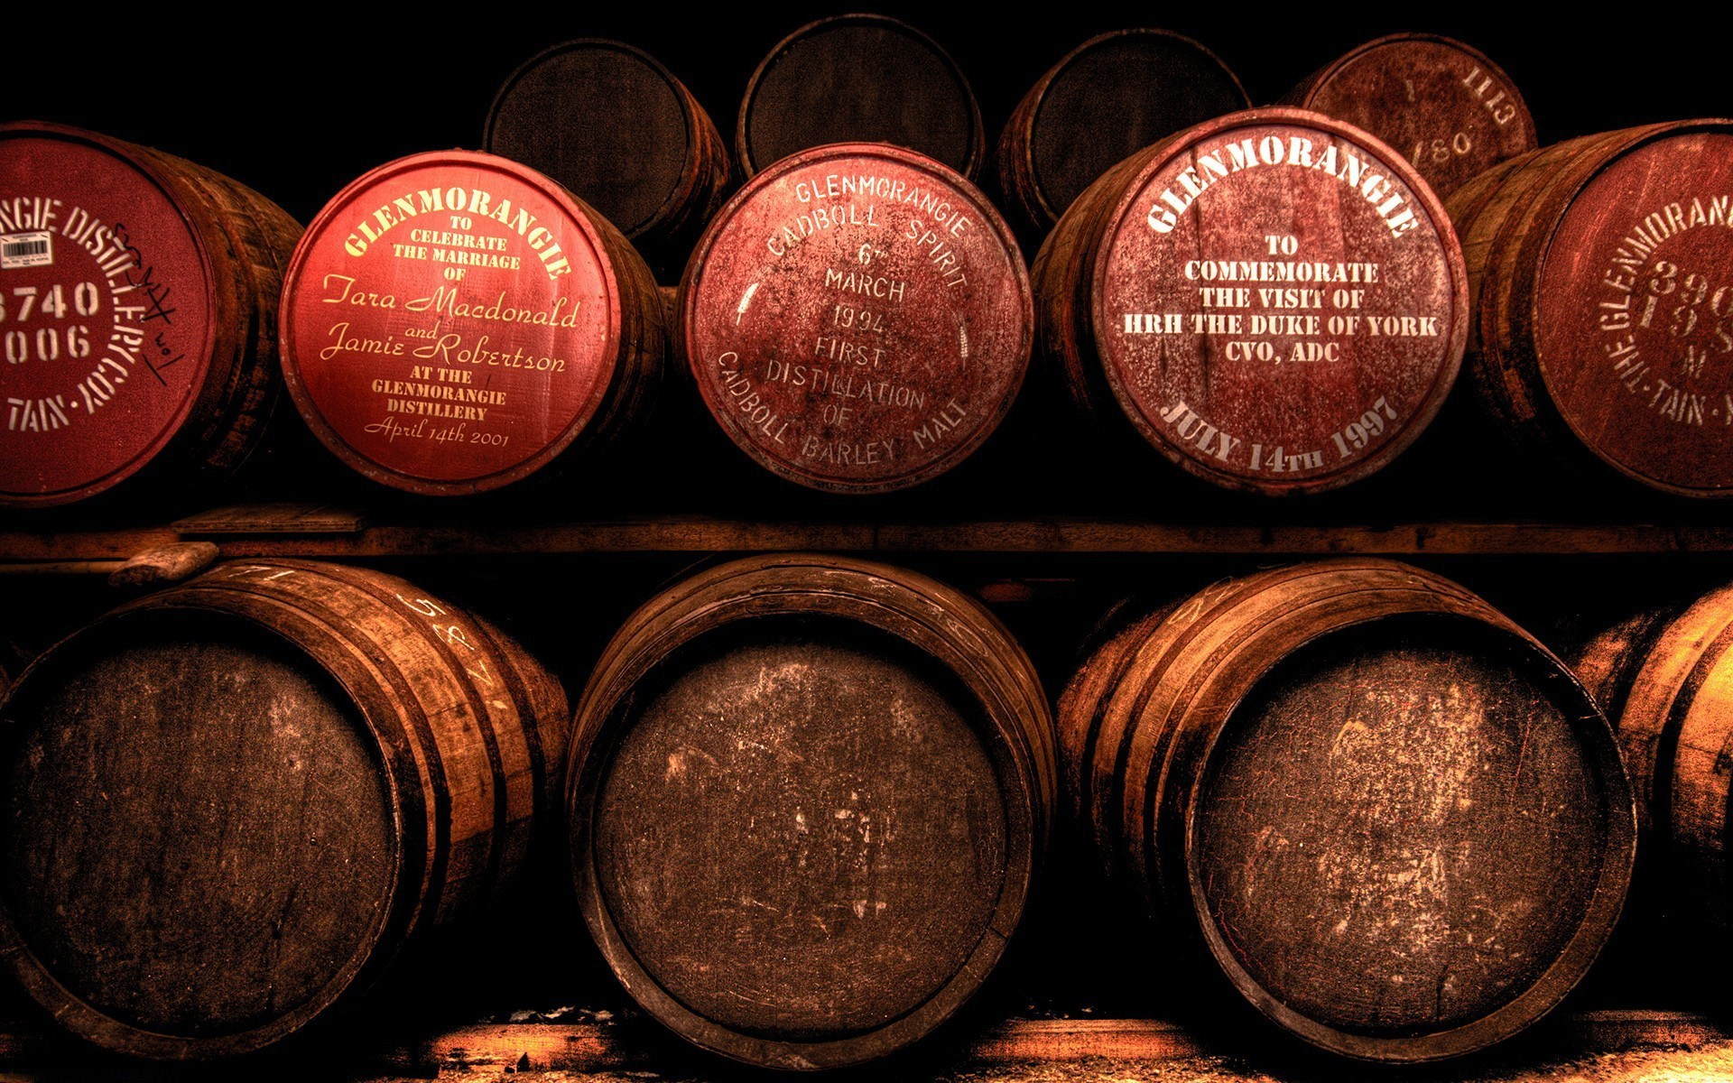
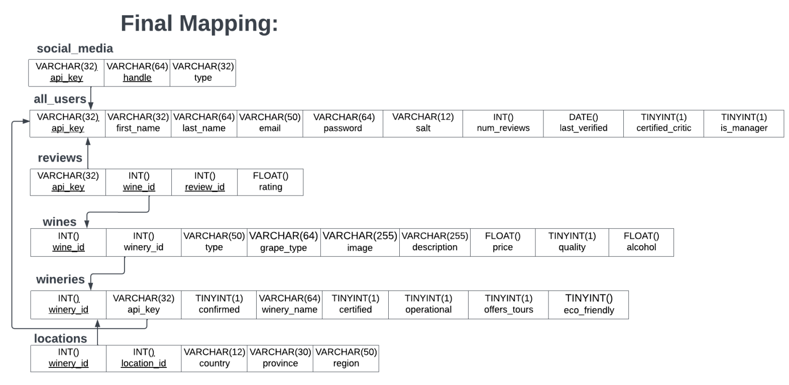
(E)ER-Diagram to Relational Mapping

Slide 6

Relational Schema

Slide 7

Relational Schema Continued
Keys:
Constraints:
Type constraints:
Checks:

Slide 8
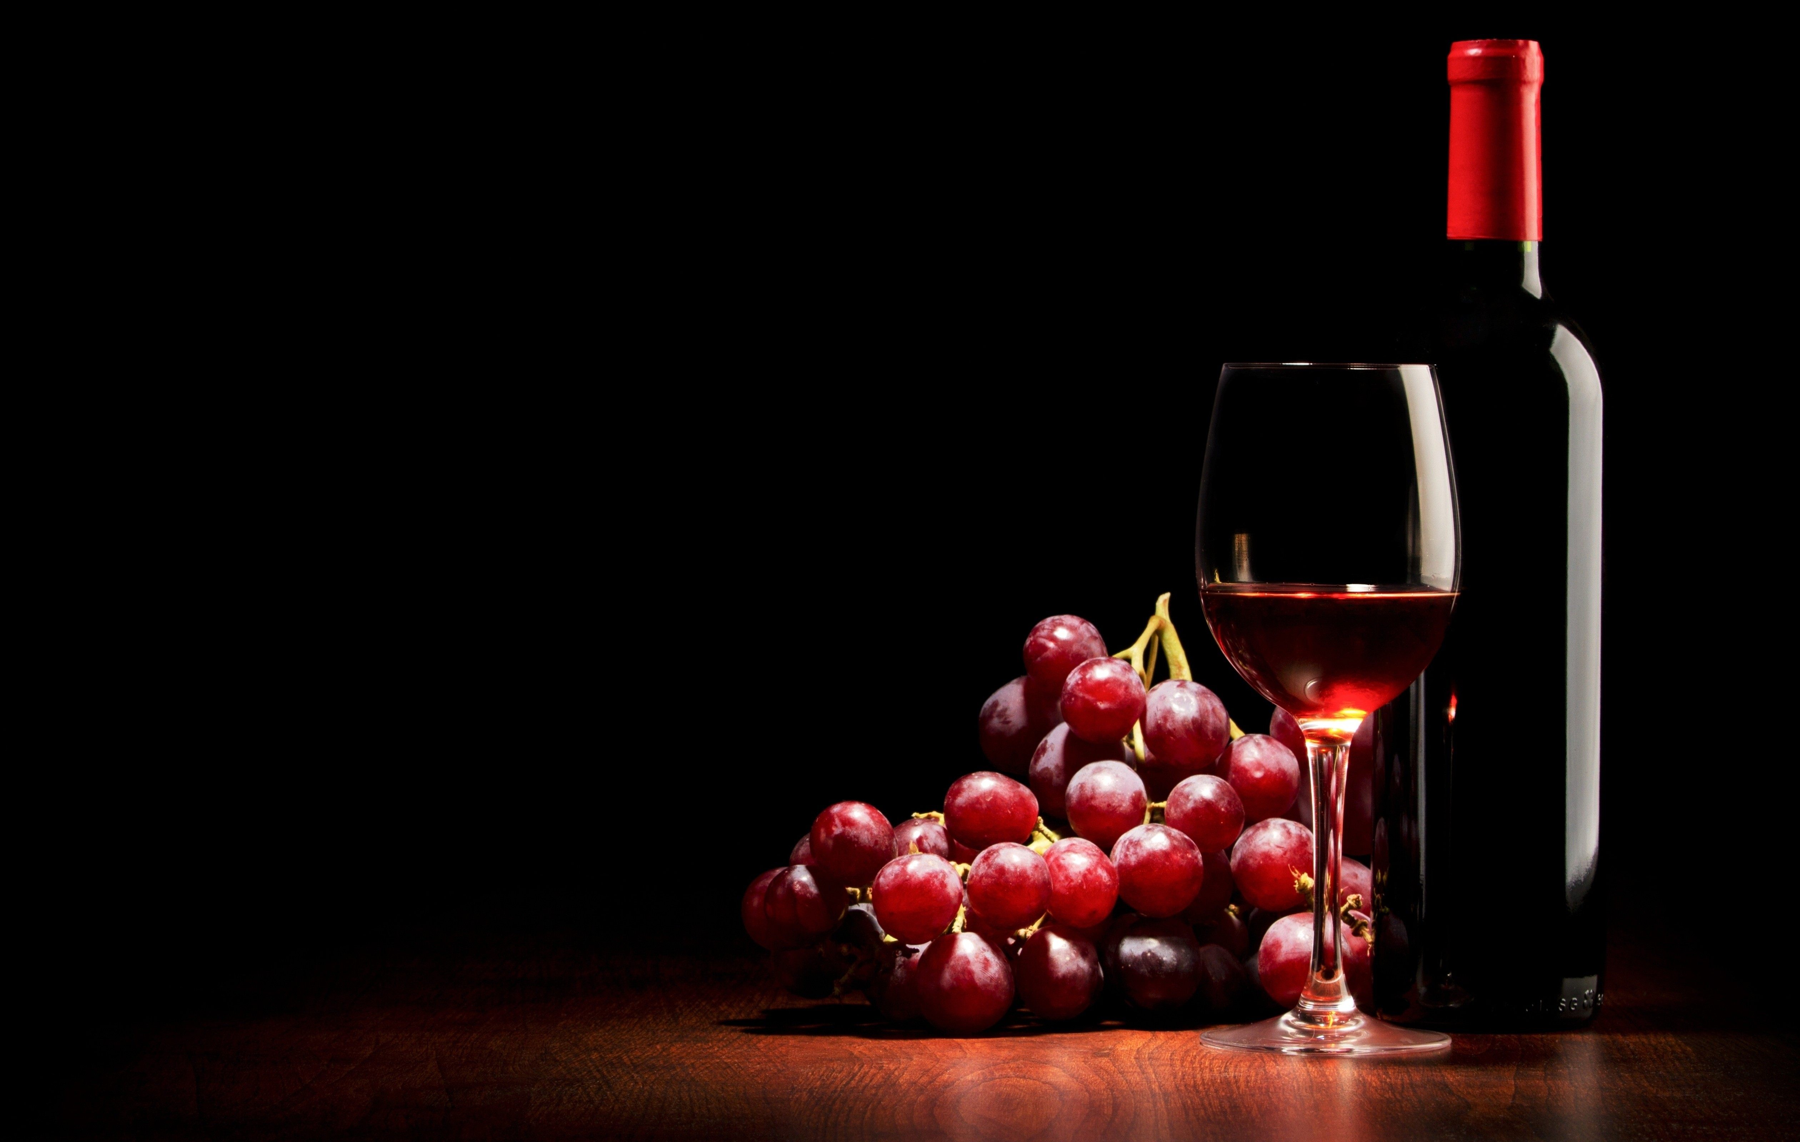
Data Distillery Website

Slide 9

Data
PRESENTED BY JULIA, JANICKE AND CHARL
Explanation and script vs manual
Actual Data
9

Slide 10
Development
PRESENTED BY CHARL AND IVAN
The wine industry massively contributes to South African tourism thus a centralised website for easy access to information about wines helps to give our tourists a more enjoyable experience without the hassle of having to do their own research about wineries and wines. A detailed overview of our research can be found in the research doc.
README
10

Slide 11
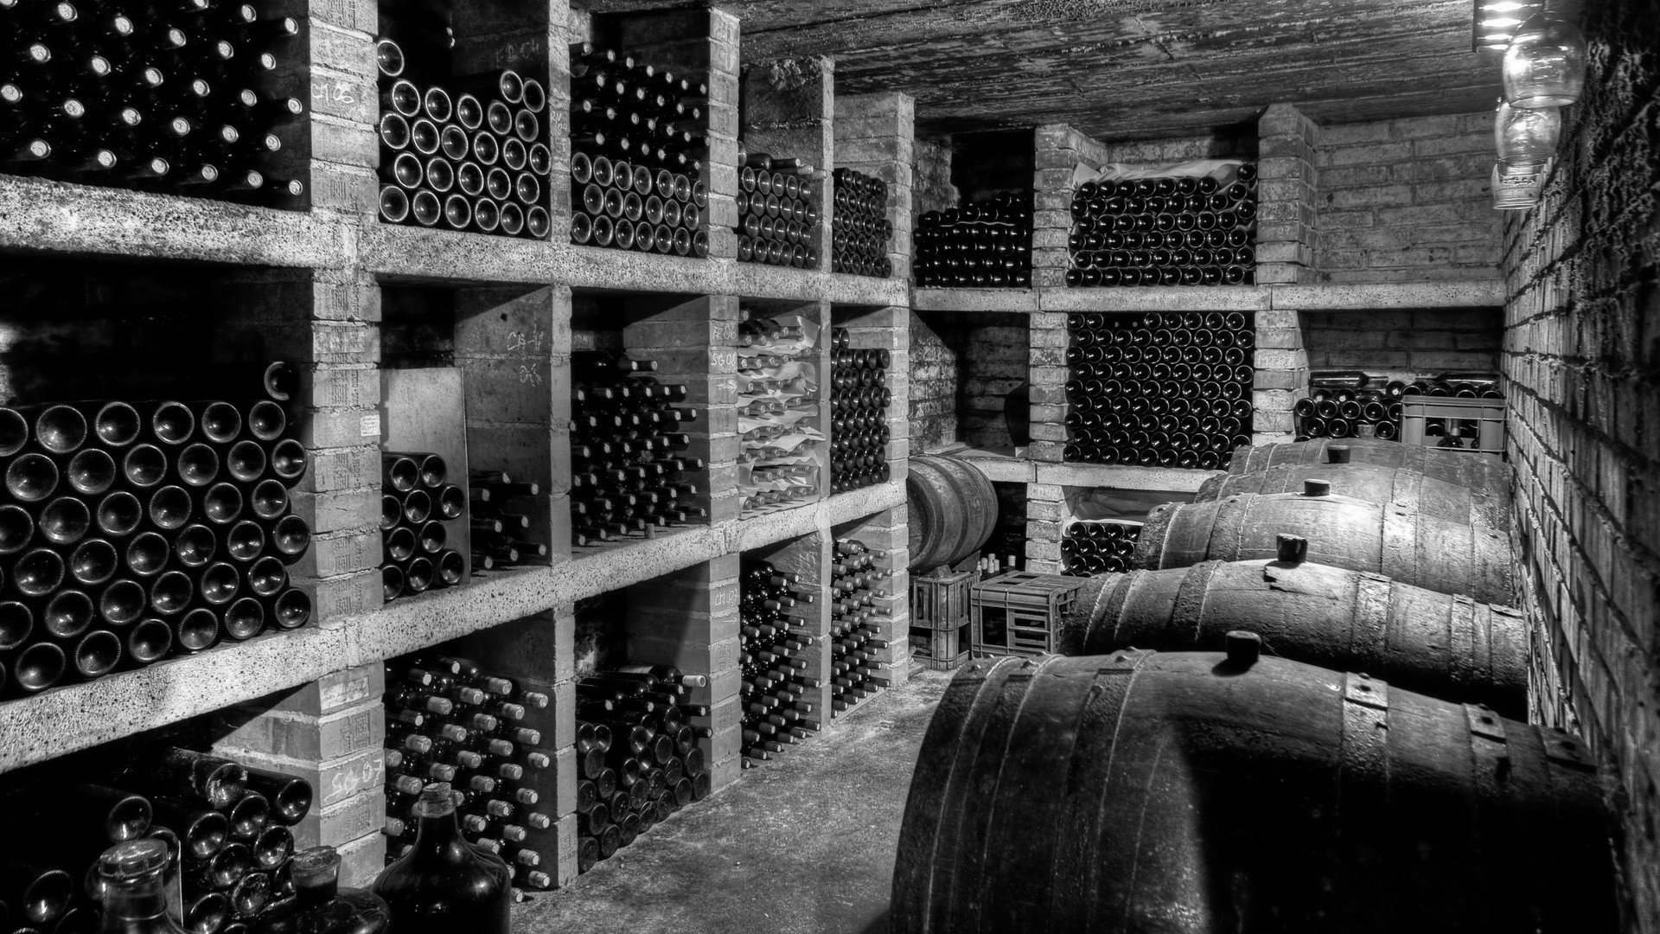
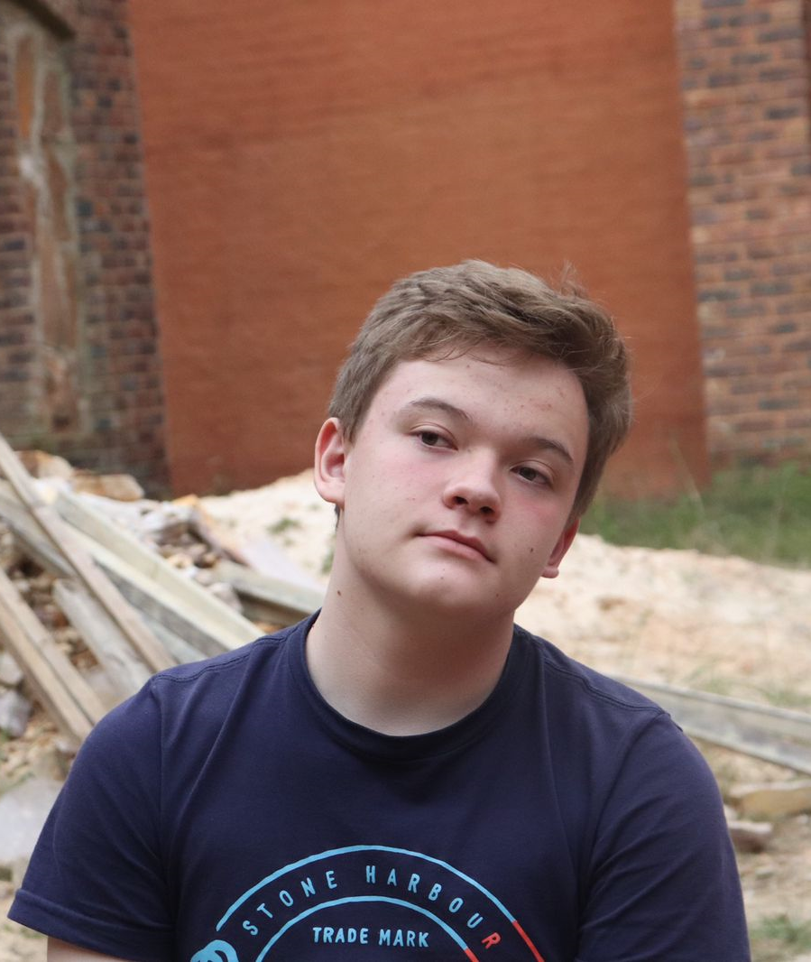
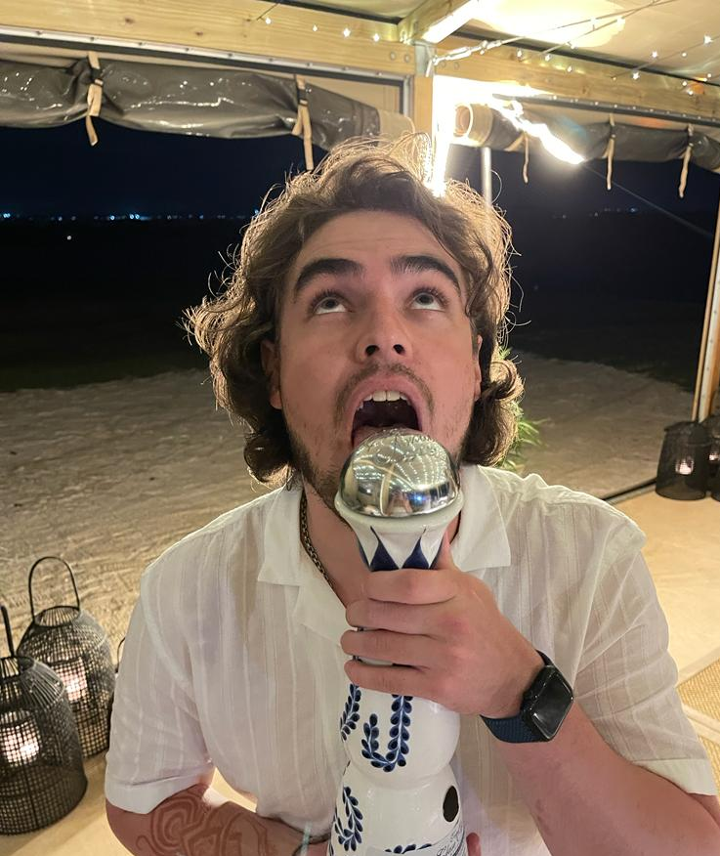
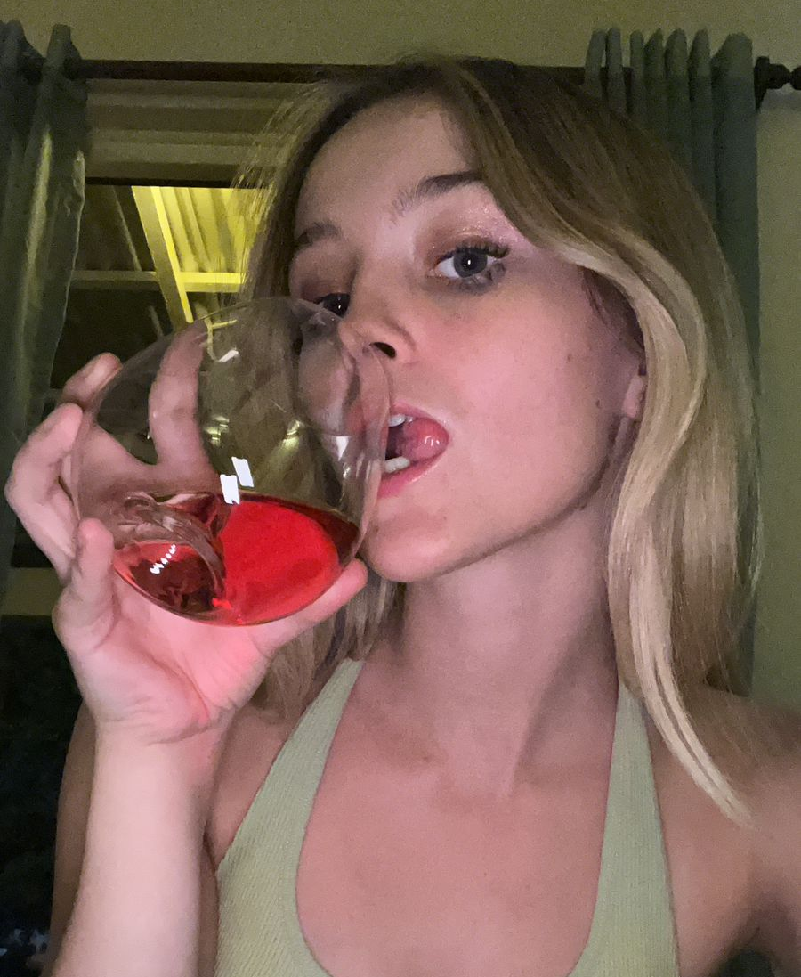
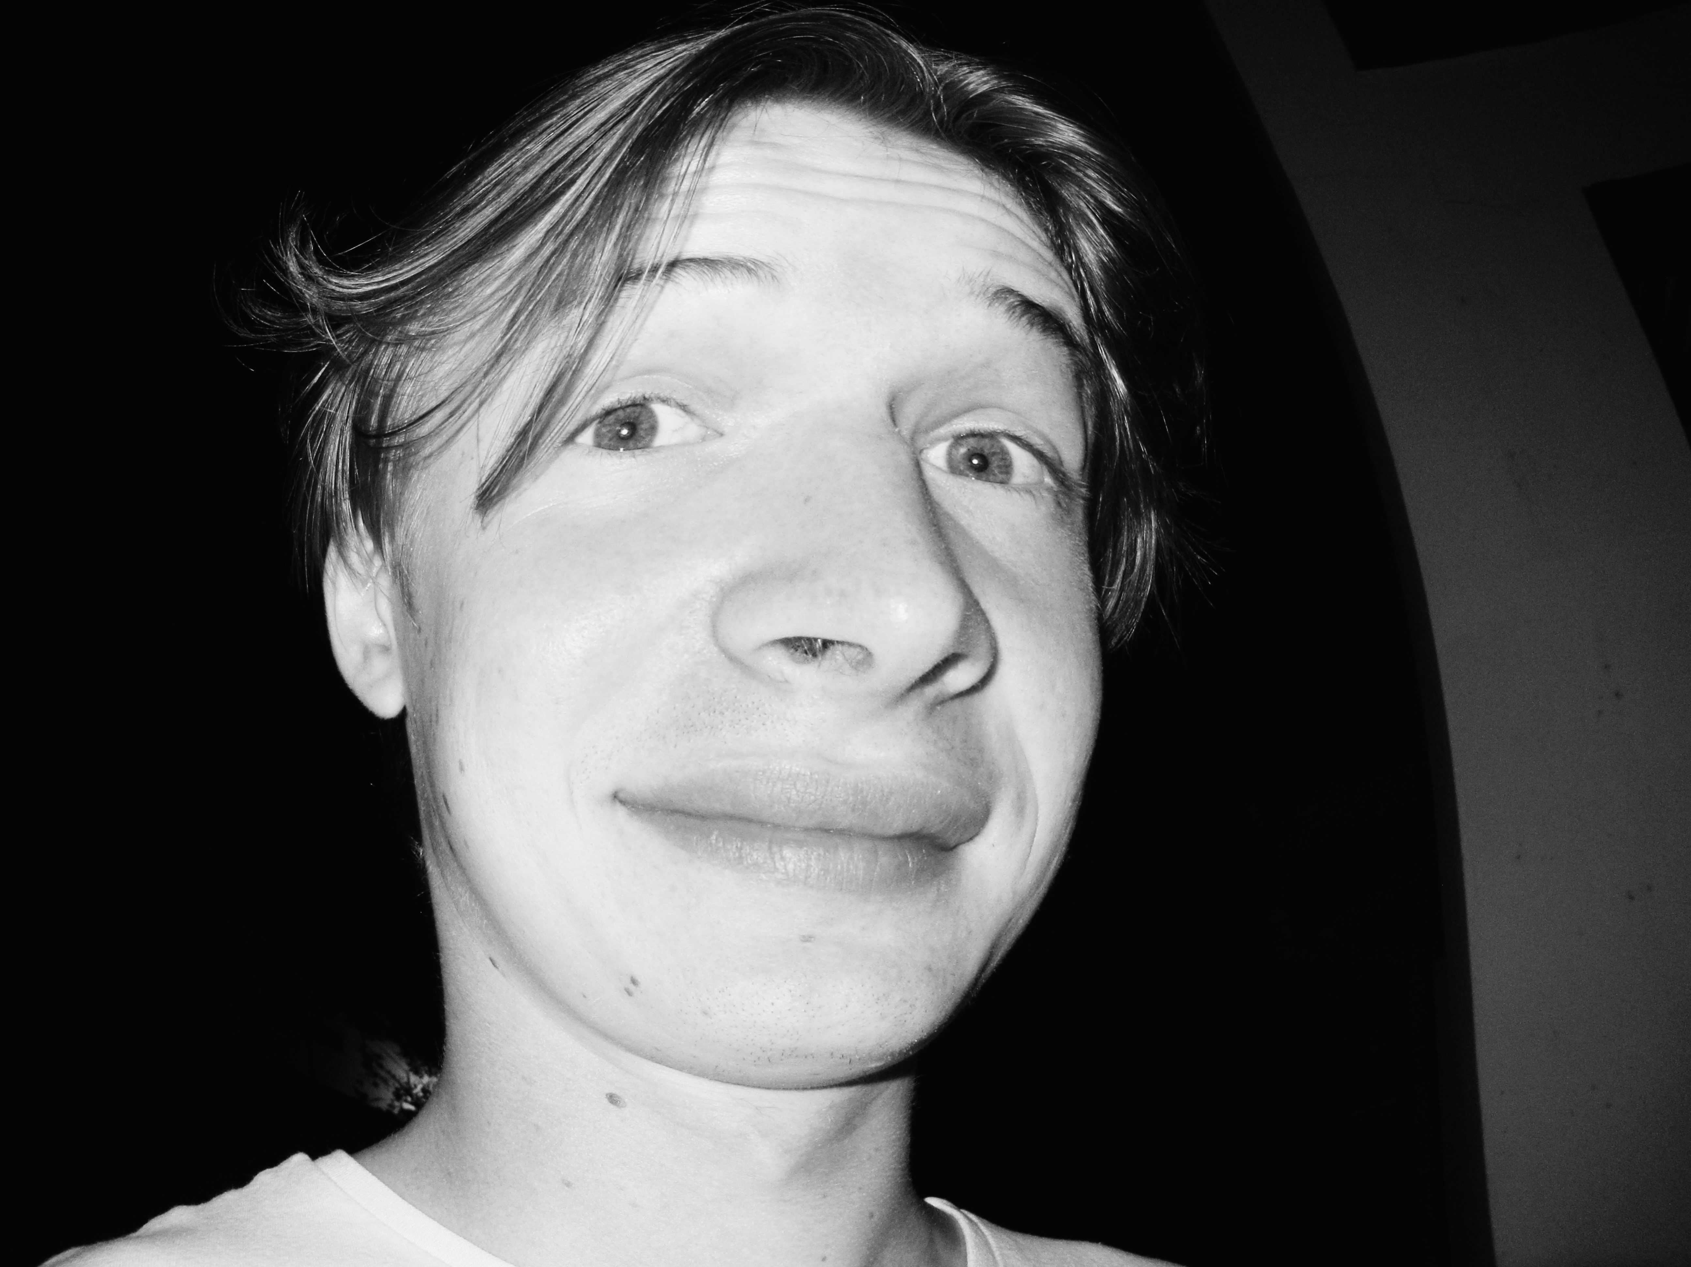
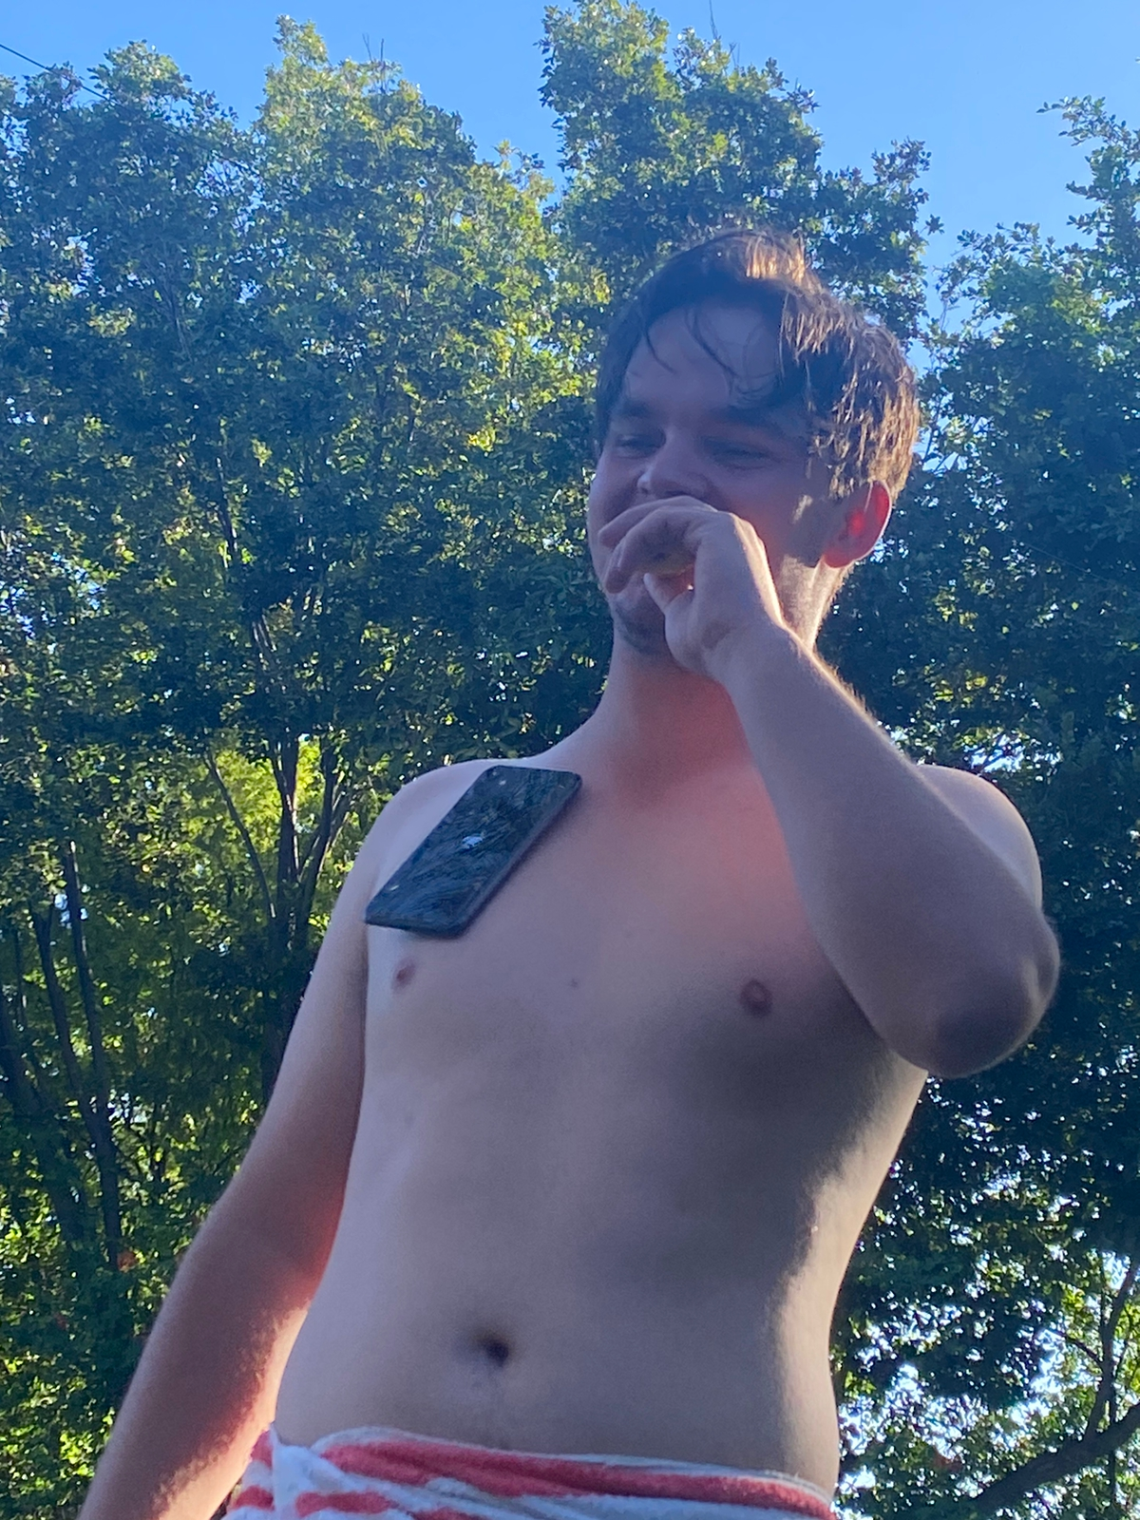

Group 12
Charl Pretorius
Ivan Horak
Julia Ortner
Matt Botha
u22519042
u21456552
u21463230
u20514612
Justin Hudson
Janicke
Lesedi
u21543152
Title
Title

Slide 12

Thank You!
Group 12

